Slide 1
NAIVE BAYES AI FOR LUNG CANCER DIAGNOSIS
Noah Black and Mathew Alexander
Notes:
Hi everyone! My name is Noah Black, and with my partner, Mathew Alexander, we created a Naïve Bayes AI for lung cancer diagnoses.

Slide 2
What is Cancer?
Group
Cells
Tumors
Prevalence
Causes
Metastasis
Cancer is a group of similar diseases
Cells rapidly proliferate without control
Proliferation can lead to tumors of malignant cells
Cancer is one of the leading causes of death
Cancer is caused from a variety of genetic and environmental
Cancer can spread through the body
Notes:
Understanding cancer is a key part of this project. We believe that there are 6 main things to understand about cancer to understand this project.
First, there are many kinds of cancer because it is actually a group of diseases. Different cancers originate in different tissues such as lung, liver, etc
In each cancer, cells are the quintessential driver of the disease. During cancer cells rapidly proliferate without control instead of dying, dying would typically occur through apoptosis.
Rapid proliferation leads to masses of malignant cells called tumors forming, these can be dangerous once they reach a certain size
Unfortunately, cancer is very prevalent –cancer is the 2nd leading cause of death in the US as kills hundreds of thousands patients annually
Next on causes – importantly cancer is both a genetic and environmental disease, however its primary root is often characterized by genomic damage
The final component is metastasis, or the mechanism by which cancer spreads. Once cancer Metastasizes, it is very dangerous and much more difficult to treat. This shows the importance of early cancer detection and treatment

Slide 3
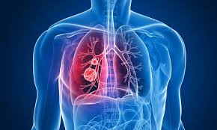
Lung Cancer Synopsis
Lung Cancer is composed of many diseases
SCLC Cancer is the 2nd most common type
NSCLC Cancer is the most common type
Lung Nodule Cancer is still prevalent and concerns this presentation
Notes:
Lung cancer is the primary concern of the project we created, so its important to understand what lung cancer is
In actuality Lung Cancer is an oversimplification of the broader disease which is composed of many kinds of Lung Cancer
One common type Small Lung Cell Cancer, or SCLC
However that comes second in volume of diagnoses to Non-Small Cell Lung Cancer, or NSCLC, which makes up the majority of cases
Still significant are the other kinds of Lung Cancer. One such type is Lung Nodule Cancer, which is the type of cancer concerning this presentation

Slide 4
The Problem
Lung Nodule Cancer diagnosis is convoluted and dangerous
Diagnosis entails repeated medical visits
Doctors use expensive CT scans to track tumor growth
To qualify for a biopsy, patients may have to wait months to over a year
The lag is potentially deadly, not to mention other harms
Notes:
After learning about the mechanisms of cancer and how it’s diagnosed, we found a problem that needs an urgent solution. Lung Nodule Cancer diagnosis is a time consuming process with many flaws that should be improved upon. Currently, once a nodule is detected, patients will return to a medical facility for months on end. Only after this arduous cycle of CT scans are patients even qualified for a biopsy to verify their cancer status. Considering malignant tumors can double in size every month and a mortality chances increase with size, time is of the essence when diagnosing cancer patients. This is without even mentioning the psychological and financial harms set on the patient. This project will attempt to expedite the time necessary for patients to qualify for a biopsy.

Slide 5
Understanding Lung Nodules
Malignant
Discovered by Chance
Broad
About 40% of nodules are malignant
Discovered when patients undergo an X-ray or other scan
There are many types of cancer for Lung Nodule Tumors
Notes:
Understanding Lung Nodules is critical when attempting to diagnose them. Some important things to note are that not all lung nodules are malignant, instead only 40% are cancer. Even then, nodules can be broken down into more types of cancer including but not limited to lymphoma, carcinoid, and sarcoma. Typically these masses are discovered during x-rays or CT scans performed on patients for respiratory illnesses. After the discovery, the aforementioned process of diagnosis starts.

Slide 6
The Plan
1
2
3
Research
Data Set
R Programming
4
5
Python Programming
AI deployment
Do background research on Lung Nodule Cancer to understand the problem
Find a data set containing the information to solve said problems
Use R to extract the necessary data to solve the problem
Refine and combine the data to prep it for the AI
Train the data under a Naive Bayes AI
Notes:
So, how are we going to approach this problem? – well it involves 5 steps
First, we need to understand and contextualize Lung nodule cancer and problems associated with the disease. This step has already been addressed through the previous slides.
Next, we’re going to find a data set containing the genomic information necessary to solve the problem recognized in step 1.
Third, using the R programming language and its libraries, we’re going to extract the necessary data from the data set
Fourth, Using the Python Programming Language and its modules, we will refine the data so it is able to be passed into a machine learning algorithm
Finally, Using Python once again, we will deploy a Naive Bayes AI to expedite the time for patients to qualify for a biopsy.

Slide 7
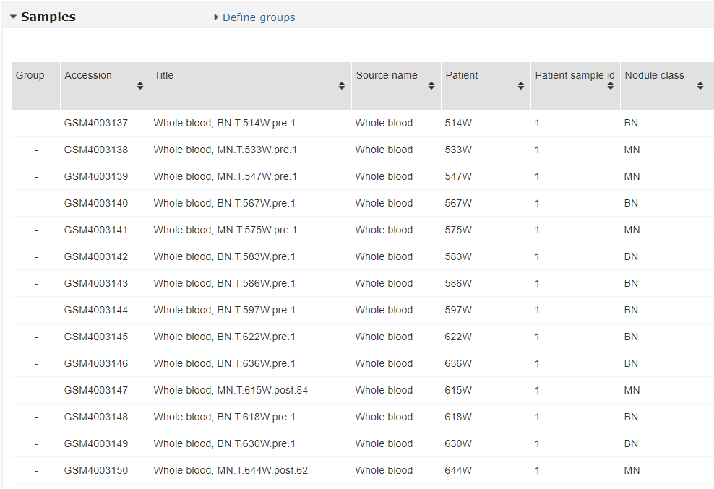
The Dataset
Found on Gene Expression Omnibus (GEO)
Named GSE 135304
Measured gene expression level of patients with malignant and benign lung nodules
Measured expression from peripheral blood
Expression level is the amount of mRNA
Notes:
All of the data used in this experiment can be traced back to a singular dataset.
This is a publicly accessible data set on the government run Gene Expression Omnibus or GEO, which is an online database for genomic data
The data set’s ID is GSE 135304, it measures the gene expression level of patients with lung nodules
These patients are either malignant or benign, and we are able to compare those groups
Note that the tissue being analyzed is peripheral blood – this is important because any results or tests derived from this dataset can be reproduced with blood from someone's forearm, for example
Additionally, expression level refers to the amount of mRNA present in the peripheral blood

Slide 8
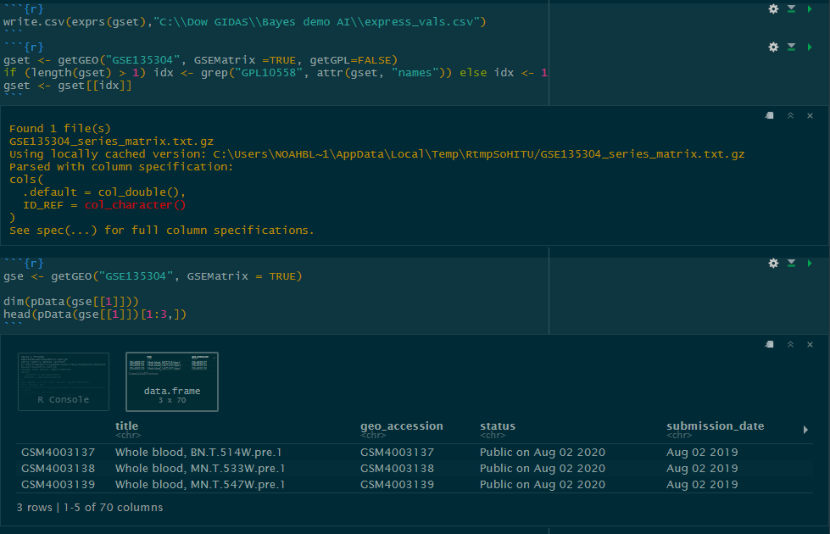
R Code
Summary:
Libraries limma, Biobase, and GEOquery used
Loaded in samples and expression from GEO
Unnecessary data values were deleted
Expression values were normalized for fair comparison
Exported file as csv to be accessed by Python file
Loaded in GSE matrix containing sample descriptors
Exported file CSV to be accessed by Python
Notes:
The first code we wrote was in the R language
The R code was primarily designed to access and locally download the data from the GSE.
We used a variety of libraries which extend the function of the raw language
In the code, 2 csv files were created to be accessed and further manipulated by the Python script
The first data frame contained the expression values of each patient, this was preprocessed for maximum efficiency. This means some unnecessary values were removed.
The second data frame, as shown in the snap shot, contained the samples and their qualifiers – This was almost immediately exported as a csv
In the second csv shown in the image, the rows represent the patients and the columns are the qualifiers, for example BN stands for benign and MN stands for malignant

Slide 9
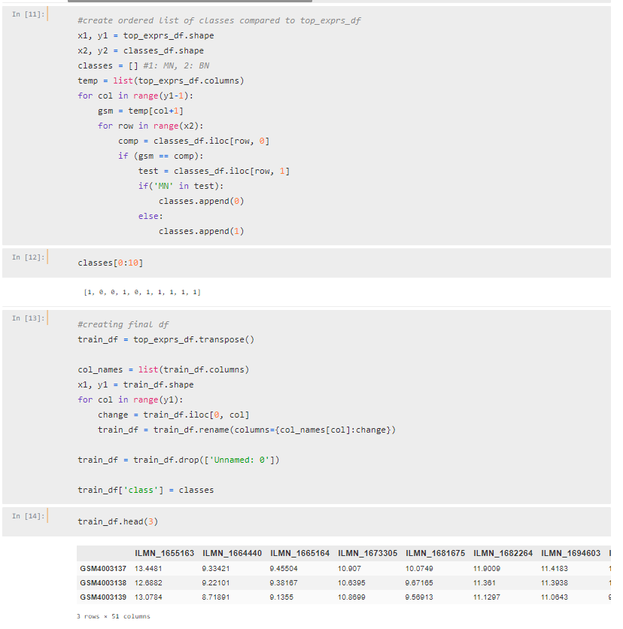
Python Code – pt 1
Summary:
Module Pandas used
Both data frames were loaded in
NaN and unnecessary data was rejected
The top 50 most differently regulated genes were chosen
Patients’ individual expression value and label were associated in a master data frame
Notes:
The first part of my Python code was designed to prepare and refine data for the AI
First both R CSV files were loaded in
The data was refined to only include the necessary data for the AI and patient assignment
We chose to use the top 50 most differently regulated genes based on adjusted P value to be inputted as AI training parameters
We thought 50 was a good choice because each of those p values is under the .05 threshold and a low number of genes lowers the manufacturing cost of microarrays
Patients' individual data was assigned to each gene. The master table is shown above. The columns are genes and the rows are patient expression values
The expression values are adjusted with a log2 function to make them more comparable

Slide 10
Naive Bayes AI
AI
Gaussian
Conditional Probabilities
Python
There are many different kinds of AI that work on different equations
Naive Bayes AI has sub-types. We choose Gaussian because of number integration
Naive Bayes works on conditional probabilities which means each input is mutually exclusive
Python has modules that allow for seamless AI development
Notes:
Lets take a look at the AI model we chose to implement
First, there are many kinds of AI that work off separate equations. This influences bias and each of the prediction mechanisms.
Even among Naïve Bayes AI, there are many kinds that work with different data structures. The Gaussian model works with numbers, so we implemented that
We chose to use Naïve Bayes for a very specific reason. Genes are regulated through a complex network of genomic and chemical factors that are almost impossible to quantify. In attempt to counteract false bias, we decided to implement Naïve Bayes AI. This is because it operates off of conditional probabilities, which through mutually exclusivity, avoids all bias – false or correct.
This will be explored next slide, but we used Python to make this AI because its modules allow for fast and efficient development of AI models

Slide 11
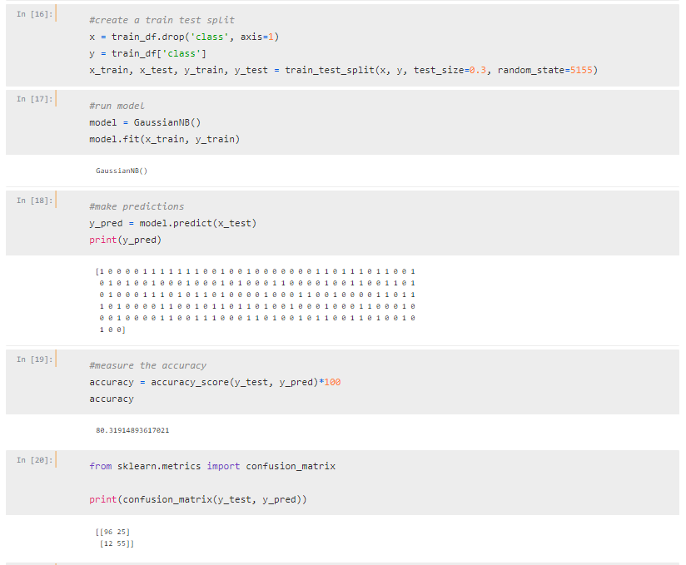
Python – pt 2
Summary:
Module scikit-learn was used
The training split and random state was chosen
A model was fit
Predictions were made
Accuracy and other stats were found
Notes:
The second part of the Python code was the actual development of the AI model.
Scikit-learn, a prominent AI module for python, was used to craft the ml program because of its versatility and ease of use
First, the training state and split were chosen. We chose random state 5155 to optimize the AI for results. A 70/30 split was executed, which means 70% of the data trained the AI, while 30% verified its fidelity.
Second, The Guassian model was fit and the data trained the AI
Next, predictions of the remaining 30% were made
From this test and others, we derived a efficacy and cumulative stats for the program
Lets take a look at those numbers

Slide 12
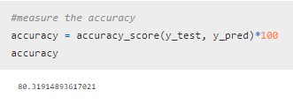

Results
80% accurate
Good/Very Good Diagnostic tool
Total of 37 incorrect predictions
25 false positives
12 false negative
Program overestimates false positives
Notes:
The results of this program are extremely promising for medical implementation
With an overall efficacy of just over 80%, the diagnostic potential of this tool is considered good to very good.
Out of a possible 188, the program only mis predicted 37 samples
That breaks down into 25 false positives and 12 false negatives
Once the number of data points in each category is normalized, we find the program overestimates the number of false positive samples. We believe this may be the case because of over representation of malignant samples in the training data.

Slide 13
Implications
A Framework
Faster Biopsies
Other Patient Benefits
This project creates a system and frame for future projects to expand from
Faster times to qualify for biopsies has the potential to save lives
Patients may save medical expenses and avoid psychological distress
Notes:
We hope that there are many positive effects of this work
First we hope this project creates a framework – this project could act as a catalyst in both code and idea for other medical test advancements. Future projects can build from the knowledge of this one.
Perhaps most importantly, this project could lead to faster biopsies – more patients qualifying for biopsies sooner has the ability to save lives as treatment can start earlier.
And finally the expedited time may save expenses and the psychological hardships that patients may have to endure for months on end as they are under constant scrutiny from doctors under the traditional diagnostic trajectory.

Slide 14
Democratization and Ethics
1
2
3
Democratization
GitHub
Free
4
5
Open Source
Patients
Having access to data and science is critical to researchers on a budget
I have made all of my resources available on GitHub
All of the resources are free to access by anyone
All of the data used for this project is 100% free to the public
All of the patients are protected (only their expression data is known)
Notes:
One of the most important aspects of any science experiment are it guiding ethics.
Democratization is very important to me and my partner, that means making something accessible. We believe democratization is important because if science is going to have any bearing on the lives of the people it can benefit, it needs to be accessible to them. we have taken many steps to explain our science to others and make our work accessible.
All of our code, paper, abstract, and even this presentation can be accessed by anyone on GitHub. GitHub is an online repository that makes collaboration and file sharing between people especially easy.
Perhaps most importantly about GitHub is that its free. As a student researcher, I understand how frustrating not having access to capital or resources necessary to complete a project is. Because of that, we made a pledge at the beginning of this project to make all of our science free and accessible to anyone who may have the desire to do similar science or just want to learn more about novel cancer diagnostics.
All of the data and tools used for this project is free and accessible to the public. The programming tools are free and open source and the data set is free on GEO. That means this project is completely replicable by anyone.
Finally, it is worthy to note that patients’ whose data was used are protected. Their identities are not known. The only thing accessible about them is their RNA expression values and a general description of their health. they have consented to being studied via the data set.

Slide 15
Thank You!
Notes:
Thank you so much for listening to our presentation. I know my partner and I had a really fun time designing and implementing all of the code and we hope you find some value in it.

Slide 16
Resources
https://www.cdc.gov/nchs/fastats/leading-causes-of-death.htm
https://github.com/thatguynoah/JHSH_Project_2021/blob/main/Black_Noah_Research%20Paper.docx

